Slide 1

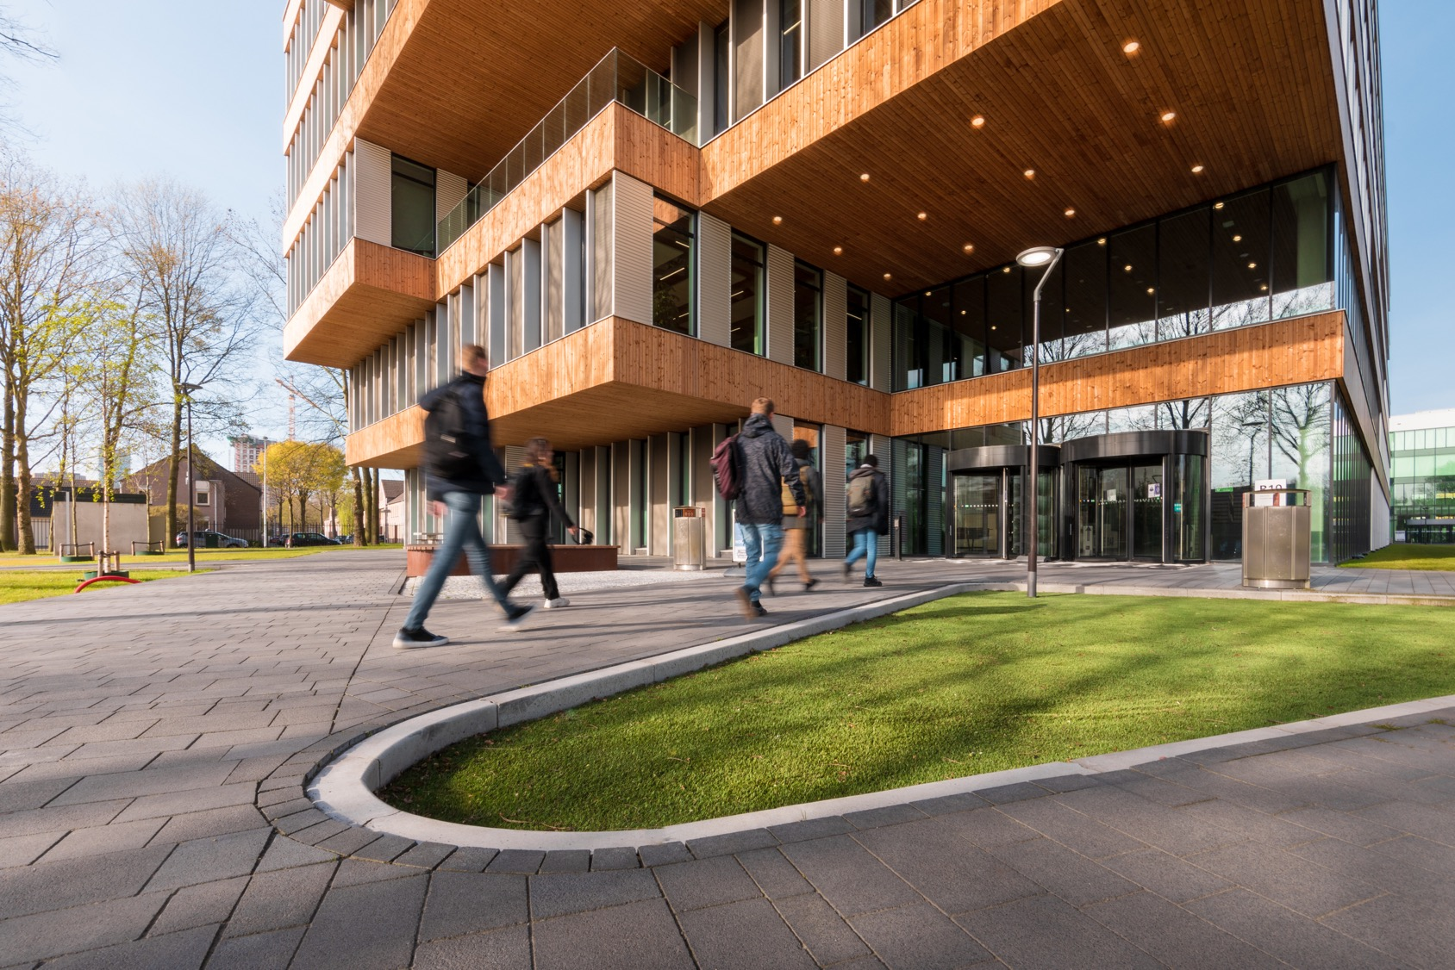

Show and grow
Name: David Hadzhiivanov
Notes:
.

Slide 2

The What
The Knowledge Hub needs a modernization in infrastructure.
Cost-considerate
Efficient
Secure
Functional

Slide 3
The Why
IT environment is:
Fragmented
Outdated
Difficult to manage
These issues result in reduced staff productivity, limited digital services for visitors, and maintenance challenges for IT personnel

Slide 4

The How?
Goal: design a simple but realistic SME infrastructure for a small library.
Documentation is done professionally with version control.
Research methods used:
DOT-Framework
Documentation and technical resources were studied to understand best practices for SME network design, VLAN segmentation, and firewall routing.
Stakeholder analysis was conducted to understand the requirements of different user groups such as staff, public users, and administrators.
Key design decisions:
VLAN segmentation to separate staff, servers, public users, and DMZ services
pfSense firewall performing inter-VLAN routing > L3 Switch doing routing with ACL

Slide 5
Evidence
Portfolio products supporting this work:
Research document
Planning document
Stakeholder Analysis
Network Design Document
IP Addressing Plan
Network Diagram
GNS3 Simulation Environment

Slide 6
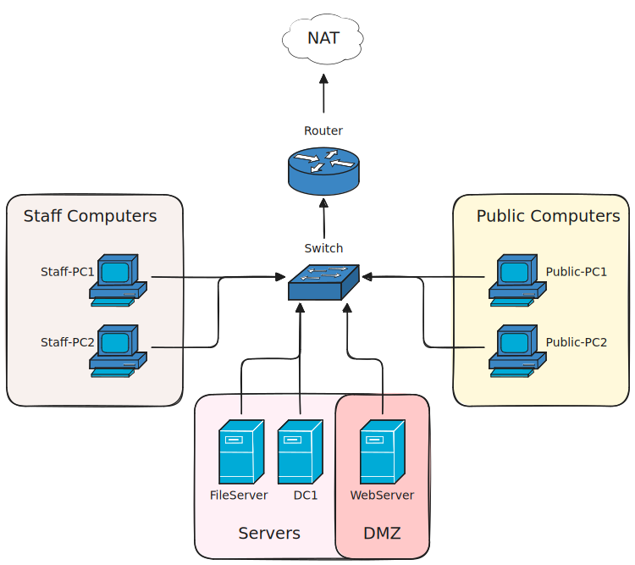
Network Diagram

Slide 7
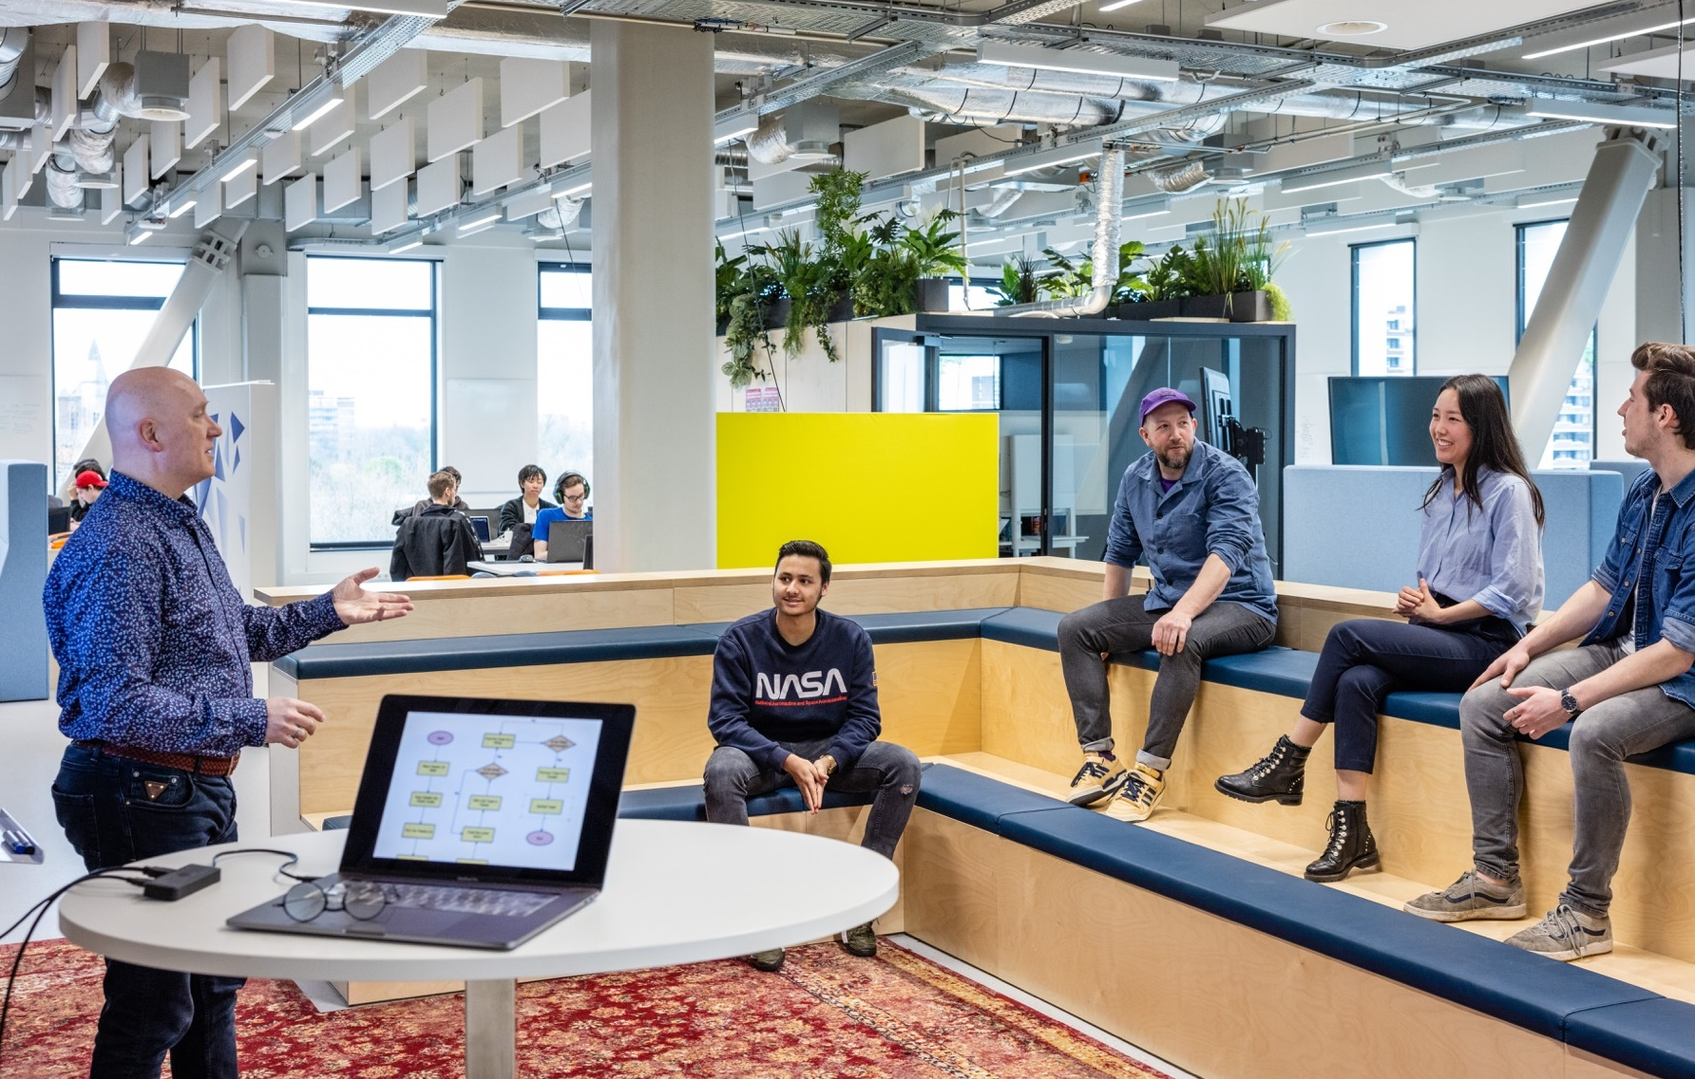
Thank you!

